Slide 1

Capstone Project – week 5
By Sharanya Sharma

Slide 2
Background
Opening a restaurant involves an extensive decision making structure
This involves permanent decisions
One such example is the location of a restaurant.

Slide 3
The Problem
It is logical to treat restaurant location as a permanent decision
Therefore, a poor location decision can be a death sentence for a restaurant

Slide 4
Data Sources
FourSquare API – neighbourhoods in and around Manhattan
More data sources are also possible and easy to use with this project

Slide 5
Data Description
The dataset looks like the following:
venue.id | venue.name | venue.location.lat | venue.location.lng | Likes
String | String | Float | Float | Integer

Slide 6
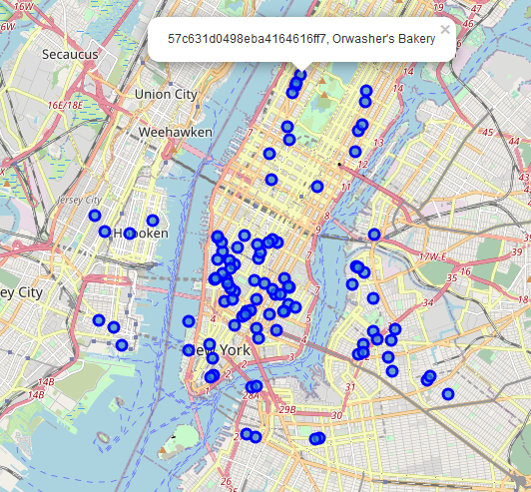
Data Visualization - Map

Slide 7
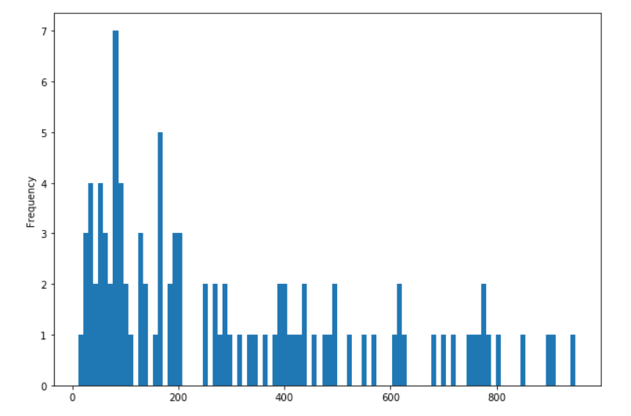
Data Visualization – Histogram (based on number of likes)

Slide 8
Possible Implications
Histogram is skewed to the right, meaning:
Higher probability of low number of likes
Few restaurants with large number of likes could be part of a cluster
This can help us determine if location is worth looking at

Slide 9
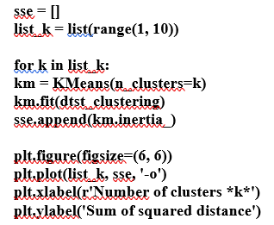
Determining number of clusters
Done using the Elbow method, with following code:

Slide 10
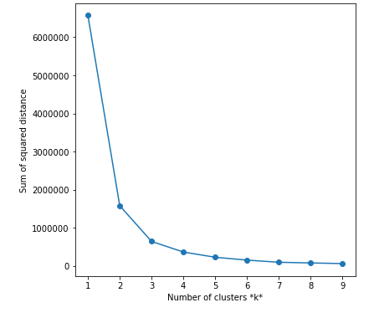
Determining number of clusters (contd)
Thus, 3 clusters to be used

Slide 11
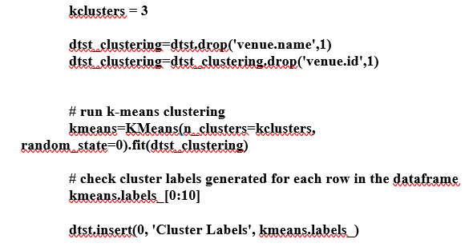
Clustering

Slide 12
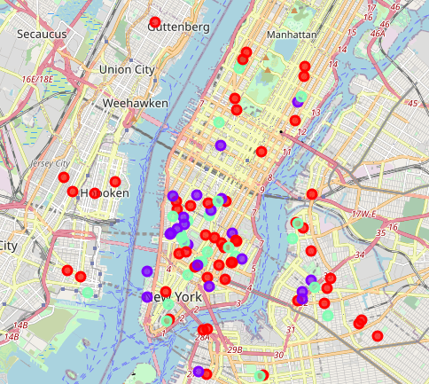
Clustering (contd)
The 3 clusters are:
Cluster 0 (red): Low number of likes
Cluster 1 (purple): High number of likes
Cluster 2 (green): Intermediate number of likes

Slide 13
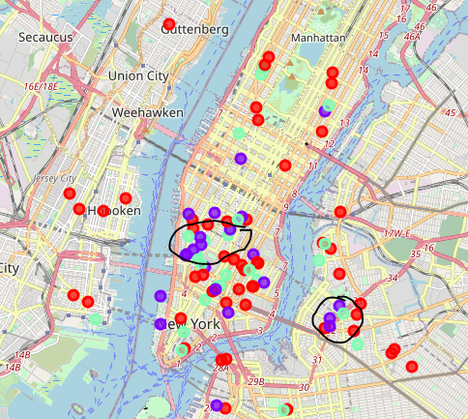
Results
Two possible locations show promising results, circled on the map

Slide 14
Conclusion
The restaurants in cluster 1 are in clustered together (location-based) where there are few or no restaurants from cluster 0 and few restaurants from cluster 2.
Thus, it is worth considering restaurant location as a factor in restaurant success

